Slide 1
Tira Beauty
Under Guidance of Mrs. Vaishali Sonawane Mam.

Slide 2
Introduction :
Tira Beauty is a new online beauty retail platform under Reliance Retail, offering a seamless and personalized shopping experience with a curated selection of the best global and homegrown beauty brands
The brand aims to democratize beauty in India by breaking down barriers and becoming the leading inclusive beauty destination, focusing on accessible yet aspirational products for diverse consumer segments.

Slide 3
Members of Team
Mahender Reddy

Slide 4
Responsibilities
Assign the sub-module and tasks to the team member.
Review the test cases of team and guide them.
Execute all the test cases.
Create defect report.

Slide 5
Overview
What is tirabeauty?
Tira Beauty is an online platform dedicated to beauty and wellness products, allowing users to explore a diverse range of products related to skin, hair, fragrance, men, bath & body, mom & baby, wellness, and personal care. Launch your ecommerce website, customize your online store and start selling your products with the prestashop ecommerce platform etc.

Slide 6
Modules
Module 1 : skin
Verified all features on the Skin page including product descriptions, quantity selection, filters, comparison options, add to cart functionality, detailed product info, and both grid and list views.
Module 2 : hair
Tested all components on the Hair page such as item specifics, quantity controls, filtering options, compare button, add to cart button, detailed product information, and display toggles between grid and list.
Module 3 : Fragrance
Evaluated the Fragrance page functionality by checking product details, quantity adjustment, available filters, compare feature, add to cart process, product descriptions, and layout views in grid and list format.
Notes:
Module 1: Signn in page
Checked all the functionalities on Sign in page which included personal info as email
address, password
Module 2: Women page
Checked all the functionalities on Women page which included item details, Quantity, Filters,compare button,Add to cart button,product info,grid,list button
Module 3: Tshirt page
Checked all the functionalities on T-Shirt page which included item details, Quantity, Filters,compare button,Add to cart button,product info,grid,list button
Module 4: All Buttons and Drop Down Arrow :
team checked if all the buttons and drop down arrows of different fields are functioning properly or not

Slide 7
Module 4 : men
Checked the Men section for all interactive elements including item information, quantity input, filtering capabilities, compare button, add to cart action, comprehensive product info, and grid/list display modes.
Module 5 : bath and body
Reviewed the Bath and Body page covering product details, quantity modification, filter usage, product comparison, add to cart interactions, product descriptions, and options for grid and list view.
Module 6 : mom and baby
Assessed the Mom and Baby page functionalities such as detailed product info, quantity selection, filters, compare button, add to cart features, full product descriptions, and grid and list display options.
Module 7 : personal details
Tested the Personal Details section ensuring form fields, input validation, save and edit capabilities, update confirmations, and proper data handling were functioning as expected

Slide 8
Defects
While running a testcase at certain point some fields are not working as it is expected which is nothing but a defect, so team have created a Defect report on those defects.

Slide 9
Defect identifier :- B_001
Defect summary :- gmail in profile part is not directed towards the email page or site.
Ø Test Id :- TC_020
Ø Test case name :- TC_information_gmail_uncilikable
Ø Module name :- personal details
Ø Reproducible :-
Ø Severity :- high
Ø Priority :- high
Ø Raised by :- Team member
Ø Assigned to :- developer Team lead
Ø Date of assignment :-
Ø Status :- pending
Ø Snap shots :-
Ø Fixed by :- developer
Ø Date of fixing :-

Slide 10
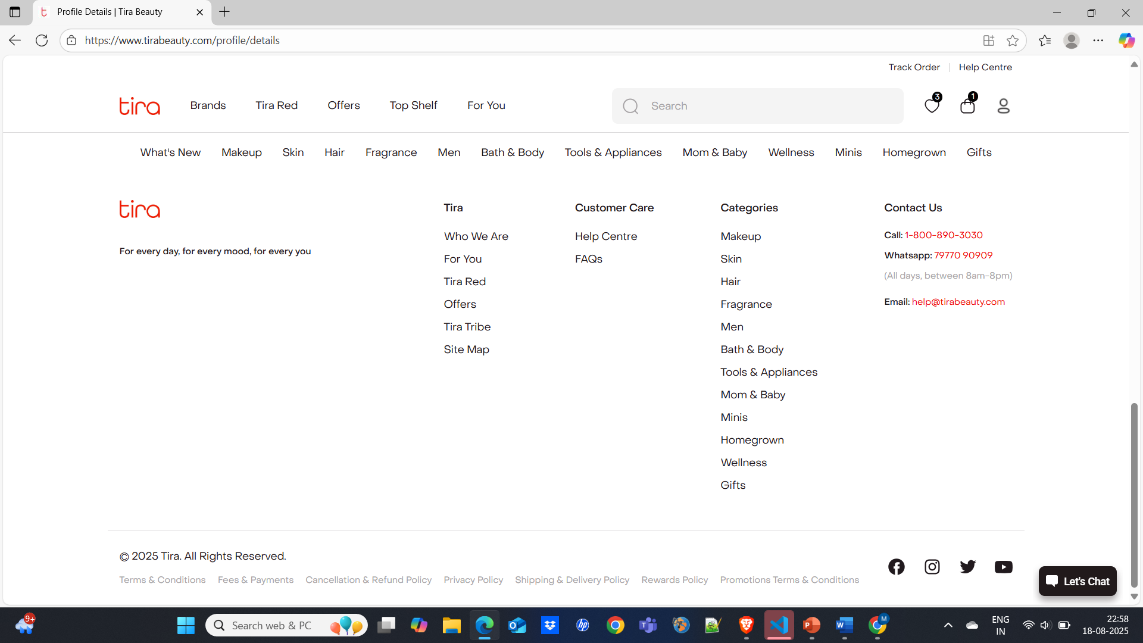


Slide 11
Defect identifier :- B_002
Ø Defect summary :- products are not displayed according their respective filters and no order.
Ø Test Id :- TC_007
Ø Test case name :- TC_assiginment order (any order)
Ø Module name :- most of modules
Ø Reproducible :-
Ø Severity :- high
Ø Priority :- high
Ø Raised by :- Team member
Ø Assigned to :- developer Team lead
Ø Date of assignment :-
Ø Status :- pending
Ø Snap shots :-
Ø Fixed by :- developer
Ø Date of fixing :-

Slide 12
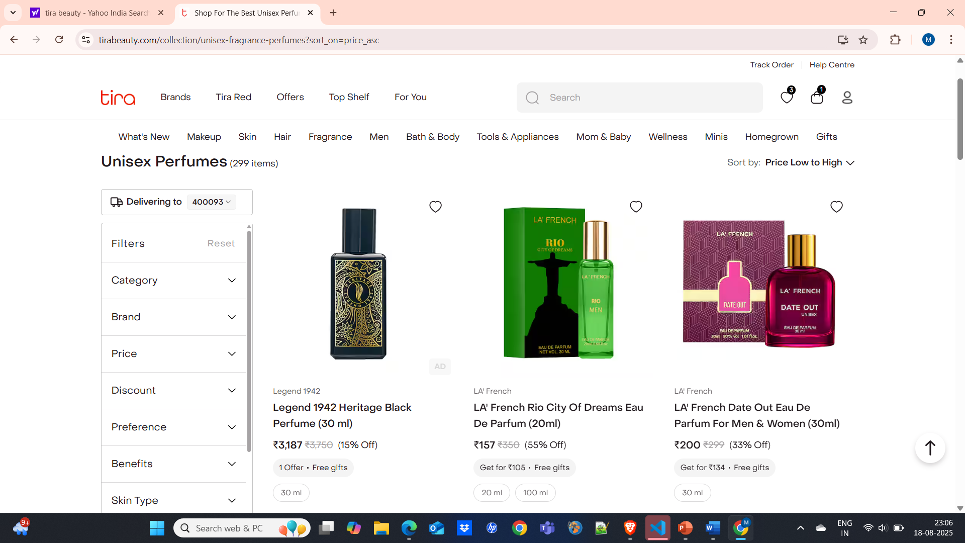




Slide 13
Challenges
While testing big website which contains huge data we faced some challenges about:
There is comes difference in writing a test case and while running it.
Sometimes Different ideas for test cases may leads to an confusion.
Interacting with elements before ready due to asynchronous loading.
Unstable tests due to timing or locator failures.
No native support for mobile applications.

Slide 14
Experience
Because of lot of communication And discussion with members it’s helps everyone to write taste case in easy way.
Help to find out bugs.
Less work because of Divdedation of modules.
Manual testing needs strong observation and in that testers needs to apply all possibilities in test cases.

Slide 15
Thank You!!!
Vaishali Mam For Guiding Us through out the Project.

